Slide 1


Slide 2
DETECTION OF DIABETIC RETINOPATHY USING ARTIFICIAL INTELLIGENCE

Slide 3
GROUP MEMBERS
S.No | Name | Roll No. | CGPA
1. | Afnan Amin | CS-104 | 3.67
2. | Aasia Batool | CS-073 | 3.534
3. | Bushra Najam | CS-111 | 3.3

Slide 4
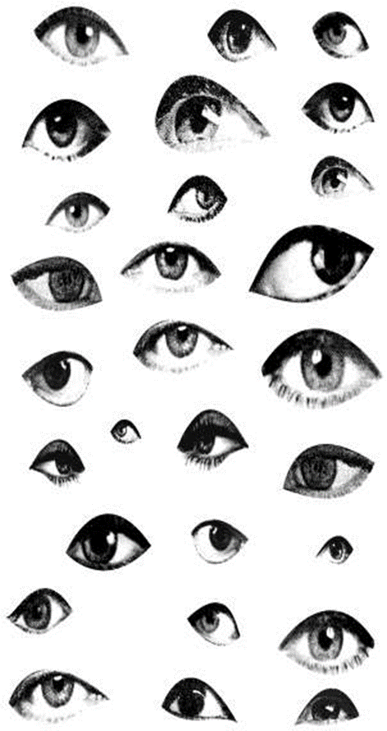
PREVALENCE
The total number of people with diabetes is projected to rise from 285 million in 2010 to 439 million in 2030.
Diabetes remains a leading cause of legal blindness between the ages of 25-65 years in the western world.
It is responsible for 1.8 million of the 37 million cases of blindness throughout the world (4.9%).
33% of patients with diabetes have signs of
diabetic retinopathy.

Slide 5
ABBREVIATED EARLY TREATMENT DIABETIC RETINOPATHY STUDY (ETDRS) CLASSIFICATION
CATEGORY
MANAGEMENT
NON-PROLIFERATIVE DIABETIC RETINOPATHY (NPDR)
NO DR | Review in 12 months
VERY MILD Microaneurysms only | Review most patients in 12 months
MILD Any or all of: microaneurysms, retinal hemorrhages, exudates, cotton wool spots | Review range 6-12 months, depending on severity of signs, stability, systemic factors, and patient’s personal circumstances
MODERATE Severe retinal haemorrhages in 1-3 quadrants or mild IRMA Significant venous beading in no more than 1 quadrant Cotton wool spots | Review in approximately 6 months (PDR in up to 26%, high-risk PDR in up to 8% within a year)
SEVERE The 4-2-1 rule- Severe retinal haemorrhages in all 4 quadrants Significant venous beading in ≥2 quadrants Moderate IRMA in ≥1 quadrants | Review in 4 months (PDR in up to 50%, high-risk PDR in up to 15% within a year)
VERY SEVERE ≥2 of the criteria for severe | Review in 2-3 months (High-risk PDR in up to 45% within a year)

Slide 6

SYMPTOMS
Diabetic retinopathy is asymptomatic in early stages of the disease. As the disease progresses symptoms may include-
Blurred vision
Floaters and flashes
Fluctuating vision
Distorted vision
Dark areas in the vision
Poor night vision
Impaired color vision
Partial or total loss of vision

Slide 7
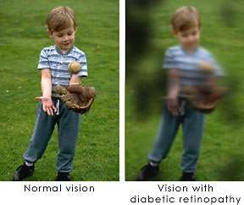

Slide 8
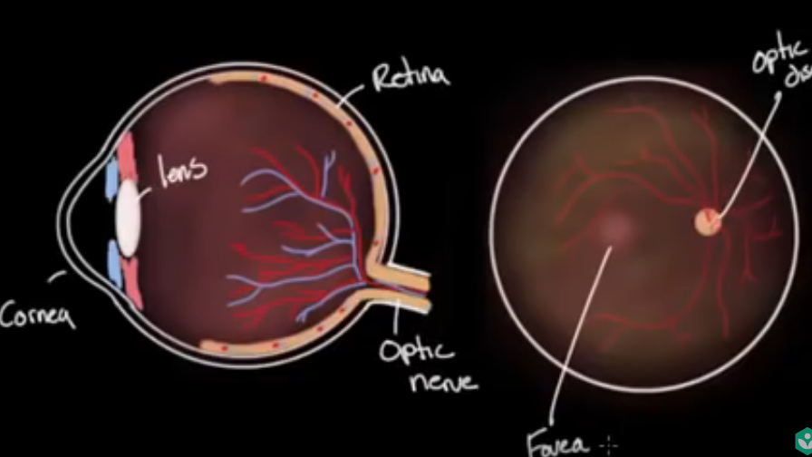
Normal Retinal Image

Slide 9
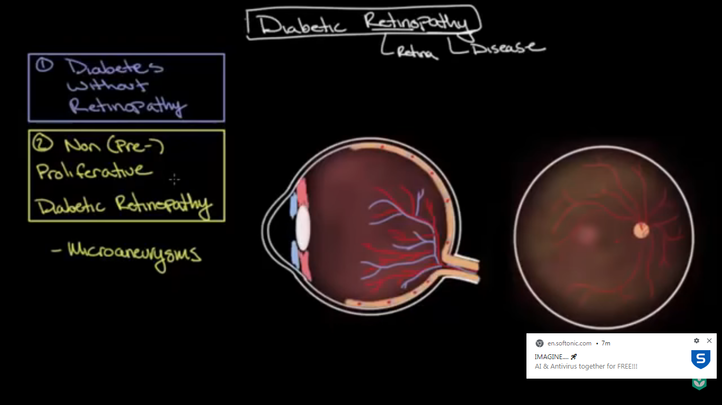
PRE POLIFERATIVE DR ( formation of mycroaneurysm)

Slide 10
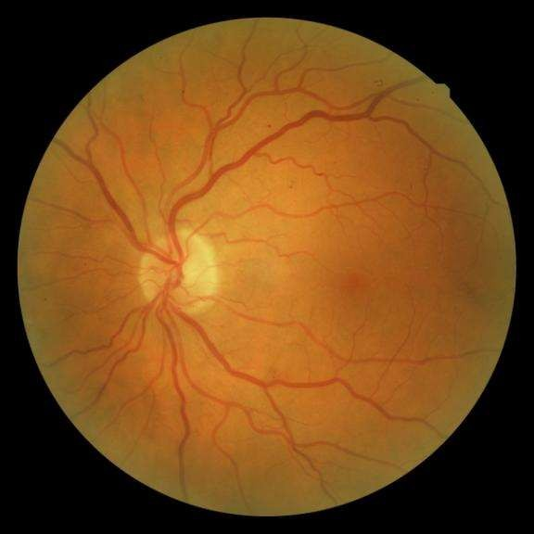
MICROANEURYSMS
Focal saccular dilatations of the capillary wall.
Size = 20-100 µm
Ophthalmoscopically visible (better on red free illumination) if larger than 30 µm.
Smaller ones can be visualized on angiography.
Maximally seen in supero-temporal quadrant.
Caused by-
-focal dilatation of the capillary wall where pericytes are absent, or
-by fusion of two arms of a capillary loop
Hyperfluorescent on fluorescein angiography

Slide 11
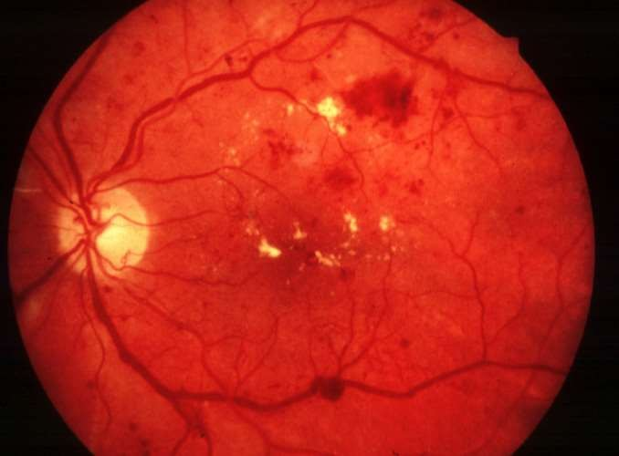
RETINAL HAEMORRHAGES
They may be small and round (dot and blot) or flame shaped depending on their depth within the retinal layers.
Retinal hemorrhage spreads along the line of least resistance, constrained by the local anatomy of the particular layer from which it arises. Therefore a superficial bleed will track parallel to the nerve fiber layer resulting in a longitudinal spread becoming flame shaped.
However deeper in the retina,
since the layers are vertically oriented it results in circumscribed, round hemorrhages (dot and blot).

Slide 12
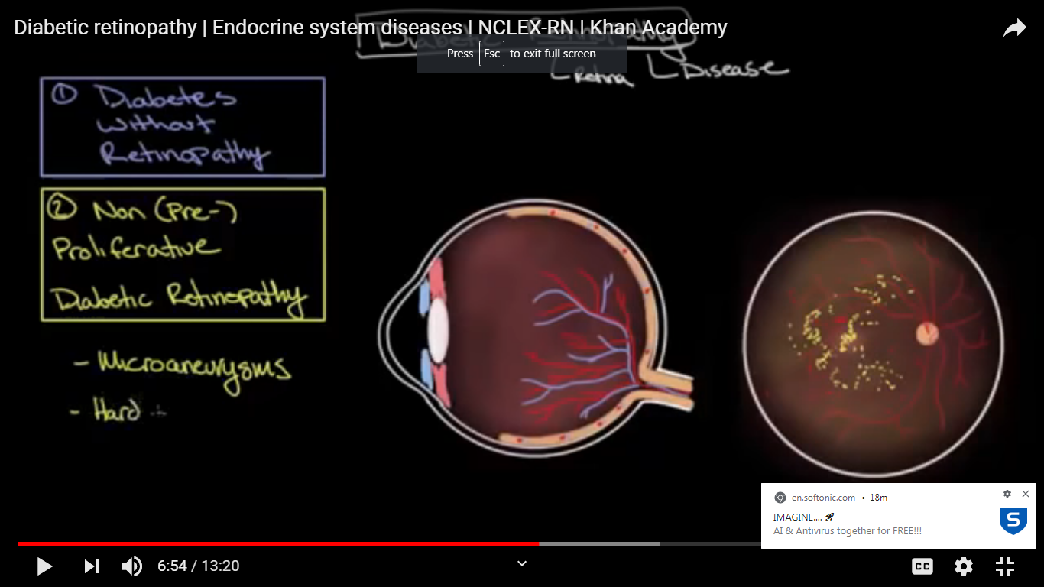
PRE POLIFERATIVE DR(formation of exudates)

Slide 13
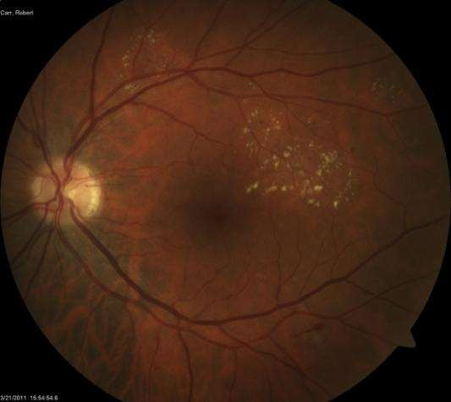
EXUDATES
Termed ‘hard’ exudates, are caused by chronic localised retinal oedema and develop at the junction of normal and oedematous retina.
Composed of lipoprotein and lipid-filled macrophages and are exuded from
microaneurysms.
Located mainly within the outer plexiform layer.
Hypofluorescent on FA.

Slide 14
Level of importance to Sustainable Design
Sustainable design seeks to reduce negative impacts on the environment, and the health and comfort of building occupants, thereby improving building performance. The basic objectives of sustainability are to reduce consumption of non-renewable resources, minimize waste, and create healthy, productive environments

Slide 15
Level of importance to Sustainable Design
Sustainable design principles include the ability to:
optimize site potential;
minimize non-renewable energy consumption;
use environmentally preferable products;
protect and conserve water;
enhance indoor environmental quality; and
optimize operational and maintenance practices

Slide 16
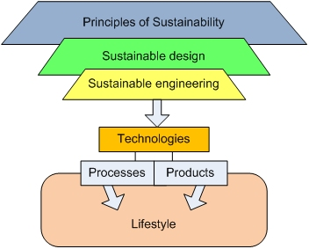
Level of importance to Sustainable Design

Slide 17
Techniques Resources & IT Tools
Techniques:
DenseNet
RestNet
VGG

Slide 18
ARCHITECTURE
Convolutional Neural Network(CNN):
Convolutional neural networks are neural networks used primarily to:
Classify images(i.e. name what they see)
Cluster images by similarity (photo search)
Perform object recognition within scenes.

Slide 19
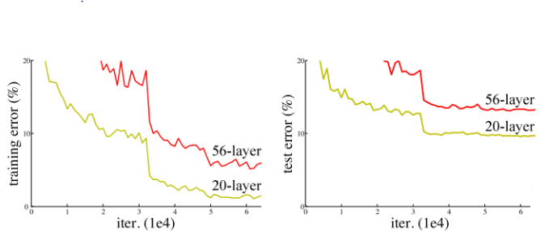
Techniques Resources & IT Tools
ResNet
When ResNet was first introduced, it was revolutionary for proving a new solution to a huge problem for deep neural networks at the time: the vanishing gradient problem

Slide 20
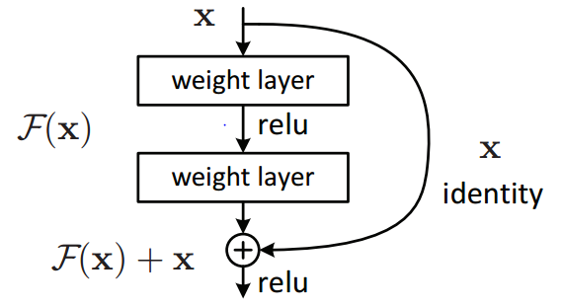
Techniques Resources & IT Tools
To mitigate this problem, ResNet incorporates identity shortcut connections which essentially skip the training of one or more layers — creating a residual block

Slide 21
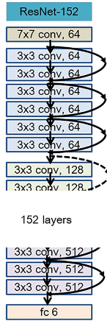
Techniques Resources & IT Tools
The overall network architecture looked like this

Slide 22





Techniques Resources & IT Tools
IT Tools:
Anaconda

Slide 23
Techniques Resources & IT Tools
Resources:
Google Engine
Some important links:
https://www.medicalnewstoday.com/articles/183417
https://www.researchgate.net/publication/330152449_Diabetic_retinopathy_detection_through_artificial_intelligent_techniques_a_review_and_open_issues
https://www.ijeat.org/wp-content/uploads/papers/v8i6/E7835068519.pdf

Slide 24
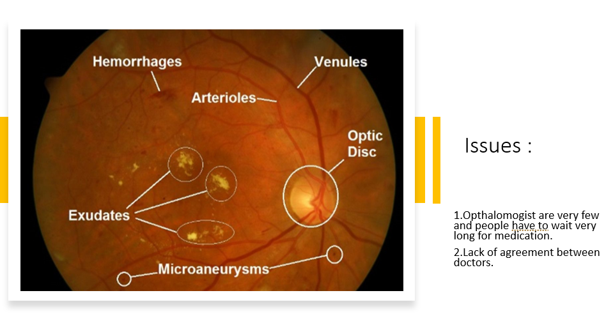

Slide 25
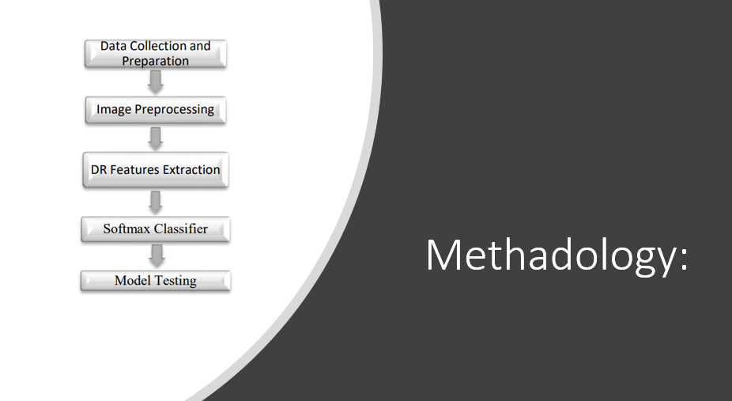

Slide 26
DATASET
This is an ongoing problem on kaggle which tries to develop a model for DR detection.
Data set consists of high resolution eye images and graded by trained professionals in 5 classes(0-4) which is according to below table and figure below that.
Class Name | Meaning
Class 0 | Normal Eye
Class 1 | Mild DR eye
Class 2 | Moderate DR Eye
Class 3 | Severe DR eye
Class 4 | Poliferative DR Eye

Slide 27
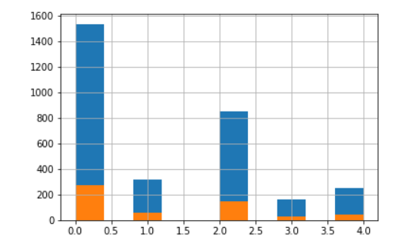
Data Analysis

Slide 28
Eye images in 5 classes(0-4)
(a) Normal eye (b) Mild DR eye (c) Moderate DR Eye
(d) Severe DR eye (e) Poliferative DR Eye

Slide 29
IMAGE PROCESSING TECHNIQUES
Retinal imaging segmentation includes
Morphological processing
Threshold
Edge detection
Adaptive histogram Equalization

Slide 30
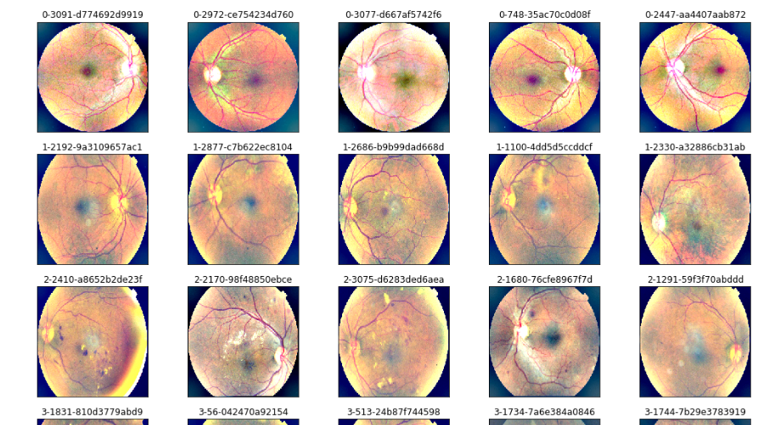

Slide 31
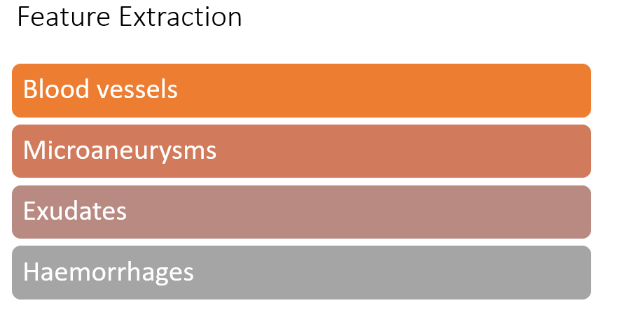

Slide 32
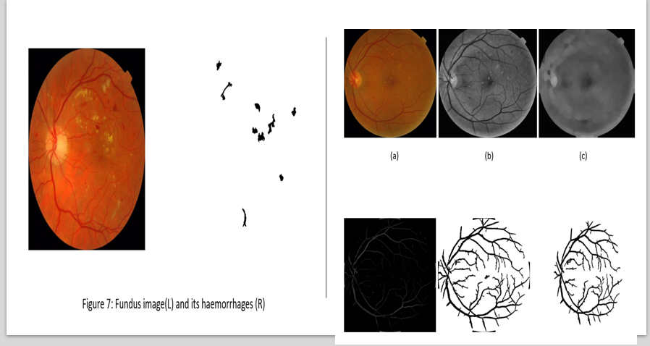

Slide 33
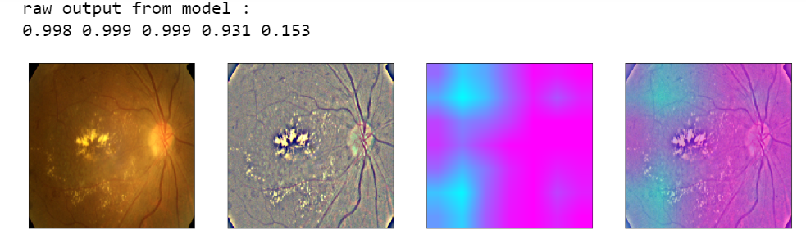
Heat Map on Images

Slide 34
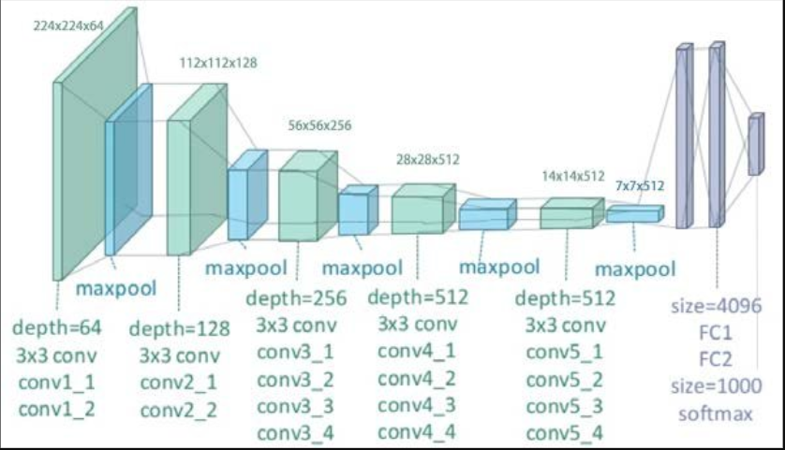
Vgg-19 Architecture

Slide 35
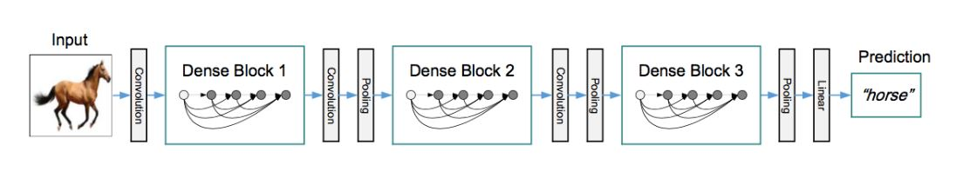
DenseNet-121 Model for image classification
Connects each layer to every other layer in the feed forward fashion.
Concatenating feature-maps learned by different layers increases variation in the input of subsequent layers and improves efficiency.

Slide 36
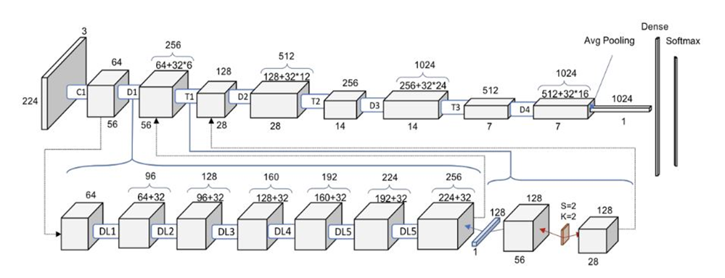
DenseNet-121
Input_image_size (224,224,3) Growth Rate=32 Dense Block=4

Slide 37
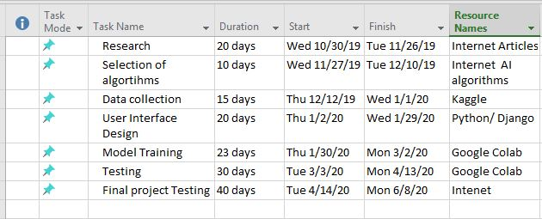
Project Planning & Scheduling

Slide 38
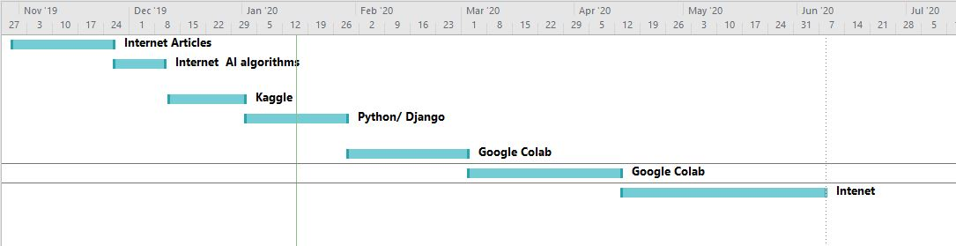
PROGRESS

Slide 39
RESULTS
By using 5000+ images as training input ,we got these results on classification.
In this way we got descent results for our analysis. It gives around 96%accuracy in the results.

Slide 40
FUTURE WORK
In future in order to improve efficiency and better results we would like to employ below modifications in the project
Increase size of test and training data set
To use better morphological analysis algorithms to get clearer features.
Implement other neural nets in a better and efficient way

